Slide 1

Data Consolidation Plan
An initiative by the data engineering team

Slide 2
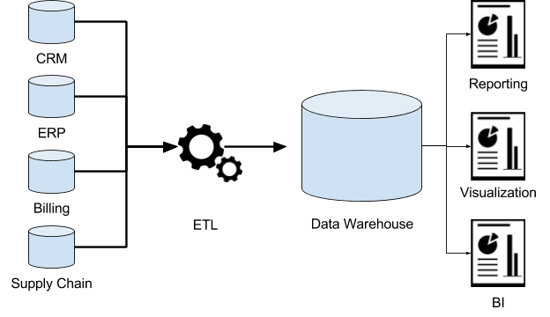
Mission
Reduce data silos to allow for improved visibility and better analytics, reporting and BI through the use of a data warehouse

Slide 3



Data Warehousing
Large store of data from a wide range of sources within a company
Enables business intelligence (BI) activities, especially analytics
Low cost, high impact solution

Slide 4
Our Use Case
Consolidate user data over multiple applications
Currently, we store our user data of our applications in each of the application databases
If we unify this data and join their accounts, we would be able to have a better overall view of the user
This would allow better user experience in the application with more user information
Consolidated data would also allow for better analytics which would allow the business to make more data driven decisions, thus benefitting the business in the long run
Historical data can be stored without affecting performance of applications
E.g. Consolidated data would bring a better view of the types of users that we should be targeting
E.g. Easily be able to consolidate financials of all our applications into one dashboard in order for the management to have an overview of the performances of our applications

Slide 5
Technical Considerations
Currently, we are using AWS to host our relational databases for our applications
We would easily be able to use AWS Pipeline in order to create a pipeline from the relational databases to a Amazon Redshift Data Warehouse
There will be a learning curve for AWS Pipeline and Redshift, as with all new technologies

Slide 6
Thank you

